Slide 1
Bayes Classifier & Naive Bayes Classifier
Donghai Guan
NUAA

Slide 2
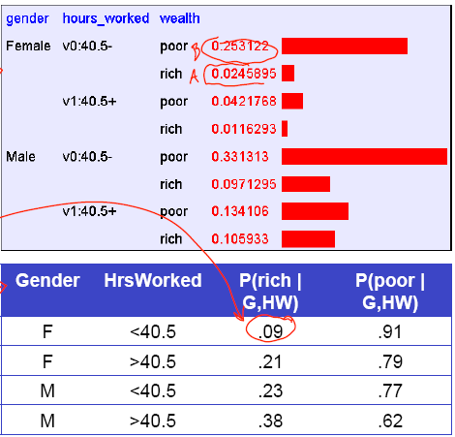
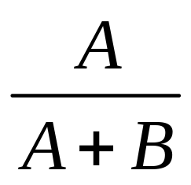
Let’s learn classifiers by learning P(Y|X)
Consider Y=Wealth, X=<Gender, HoursWorked>

Slide 3
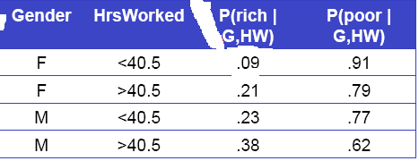
How many parameters must we estimate?
Suppose X=<X₁,…X_{n}>, where X_{i} and Y are boolean RV’s
To estimate P(Y| X₁,…X_{n})
If we have 30 X_{i}’s instead of 2?

Slide 4
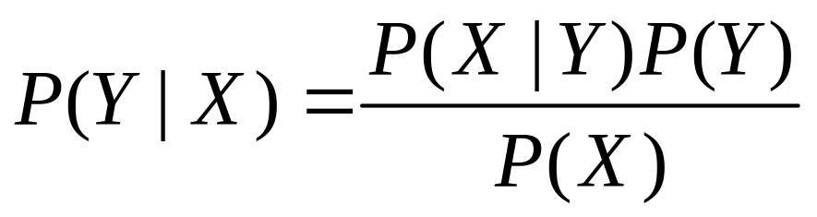
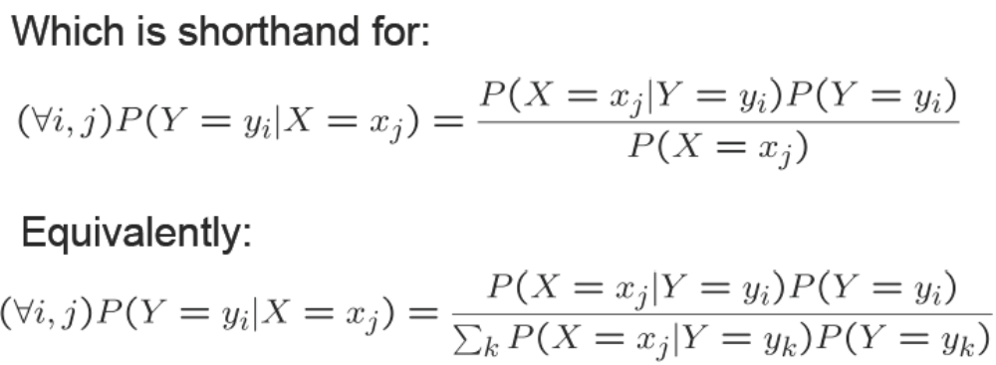
Bayes Rule

Slide 5
Can we reduce params using Bayes Rule?
Suppose X=<X₁,…X_{n}>, where X_{i} and Y are boolean RV’s
How many parameters for P(X₁,X₂,..X_{n}|Y) (2^{n}-1)*2?
How many parameters for P(Y) 1?
So total #{params} is?

Slide 6
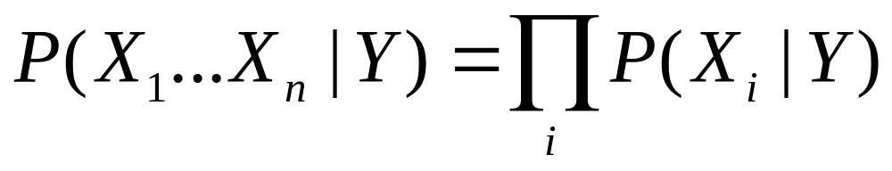
Naive Bayes
Naive Bayes assumes
i.e., that X_{i} and X_{j} are conditionally independent given Y, for all i != j

Slide 7
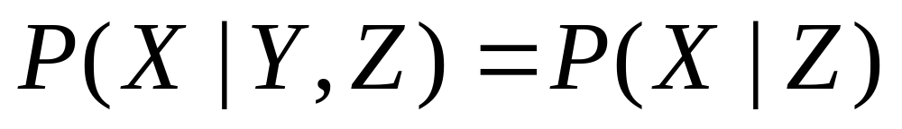
Conditional Independence
Definition: X is conditionally independent of Y given
Z, if the probability distribution governing X is
independent of the value Y, given the value of Z
Which we often write

Slide 8
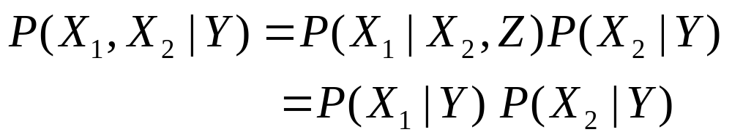
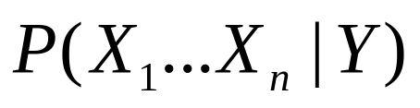
Naive Bayes
Naive Bayes uses assumption that the X_{i} are conditionally independent, given Y
Given this assumption, then
How many parameters to describe and
P(Y) : 2n+1, why?

Slide 9
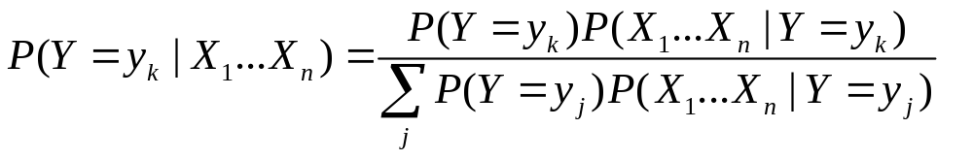
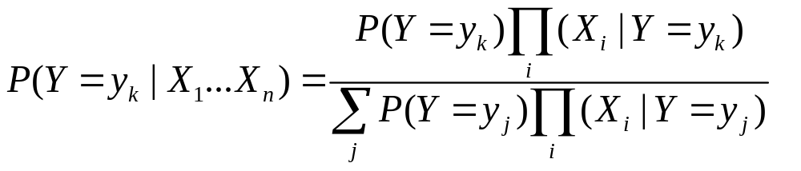
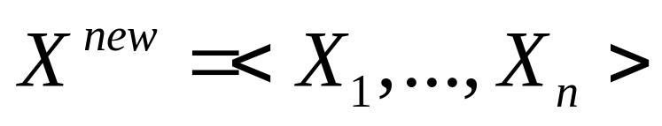
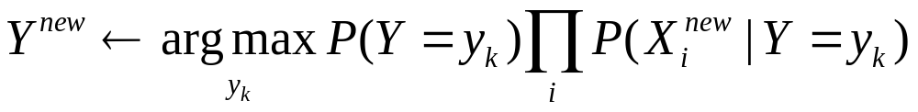
Naive Bayes
Bayes rule:
Assuming conditional independent among X_{i}’s:
So, classification rule for is:

Slide 10
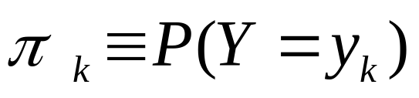
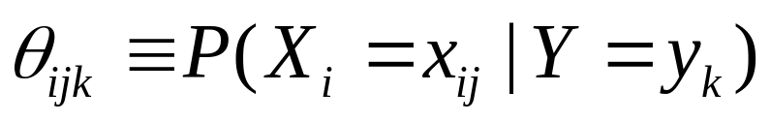
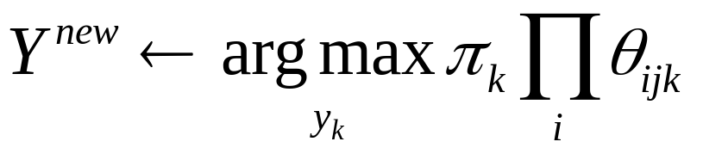
Naive Bayes Algorithm – discrete X_{i}
Train Naive Bayes (examples)
for each value y_{k}, estimate
for each value x_{ij} of each attribute X_{i}
estimate
Classify (X^{new})
* Probabilities must sum to 1, so need estimate only n-1 of these…

Slide 11
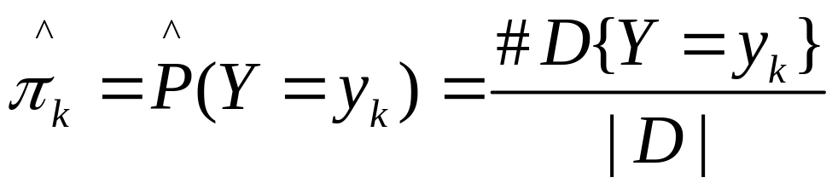
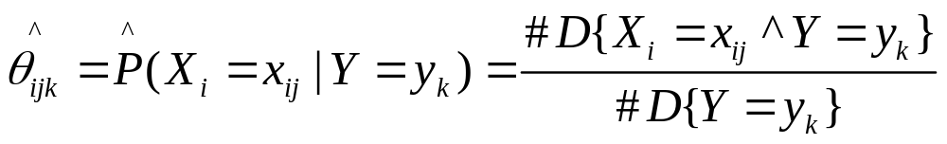
Estimating Parameters: Y, X_{i} discrete-valued
Maximum likelihood estimates (MLE):
Number of items in dataset D for which Y=y_{k}

Slide 12
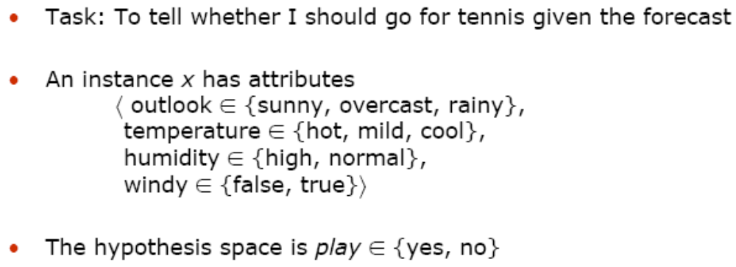
Example: Play Tennis?

Slide 13
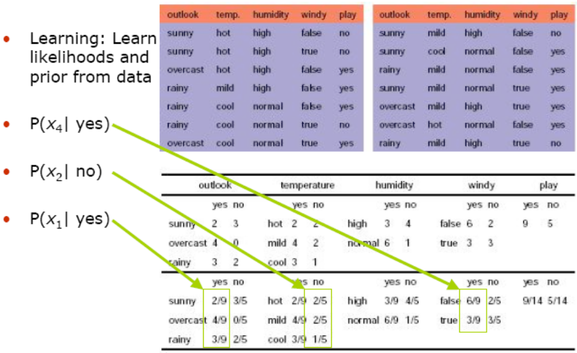

Slide 14
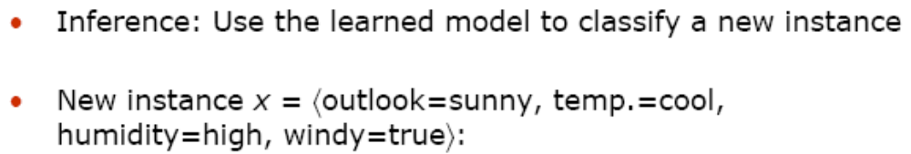
Example: Play Tennis?

Slide 15
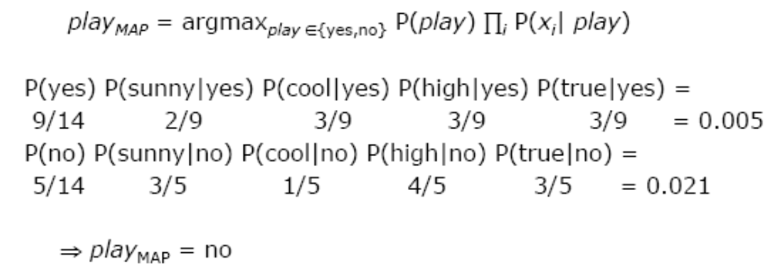
Example: Play Tennis?

Slide 16
Naive Bayes: Subtlety #1
If unlucky, our MLE estimate for P(X_{i}|Y) might be
zero. (e.g., X_{i}=Birthday_Is_January_30_1990)
Why worry about just one parameter out of many?
What can be done to avoid this?

Slide 17
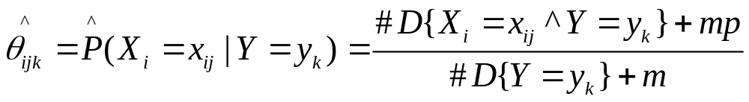

Solution
You can just imagine that we have another m training samples. And our prior estimation of is p

Slide 18
Naive Bayes: Subtlety #2
Often the X_{i} are not really conditionally independent
We use Naive Bayes in many cases anyway, and it often works pretty well
  Often the right classification, even when not the right probability

Slide 19
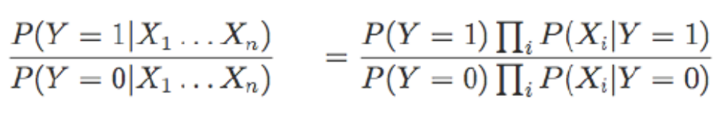
Another way to view Naive Bayes
For Boolean Y
Decision rule: is the quantity greater or less than 1?

Slide 20
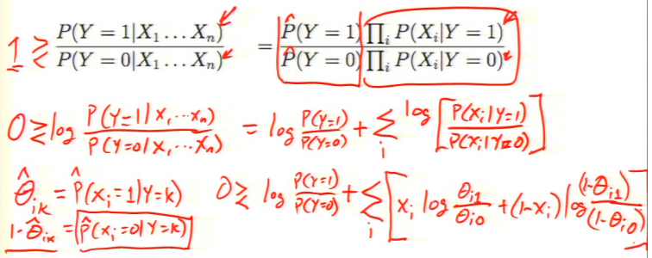
Another way to view Naive Bayes

Slide 21

Learning to classify text documents
Classify which emails are spam?
Classify which emails promise an attachment?
Classify which web pages are student home pages?
How shall we represent text documents for
Naive Bayes?

Slide 22
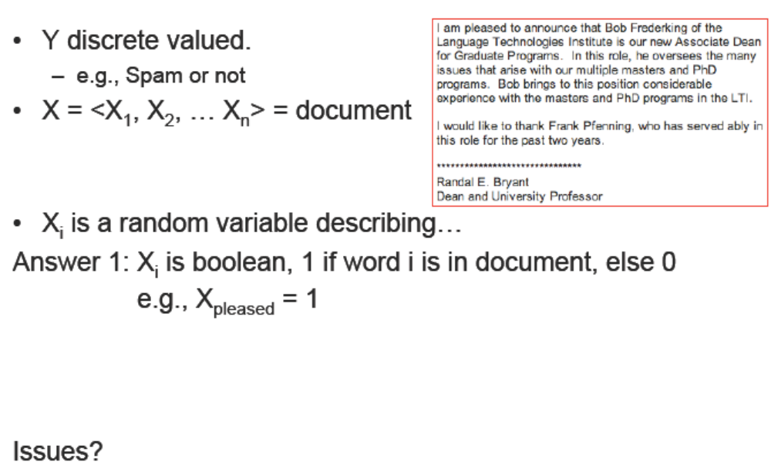
Learning to classify documents: P(Y|X)

Slide 23
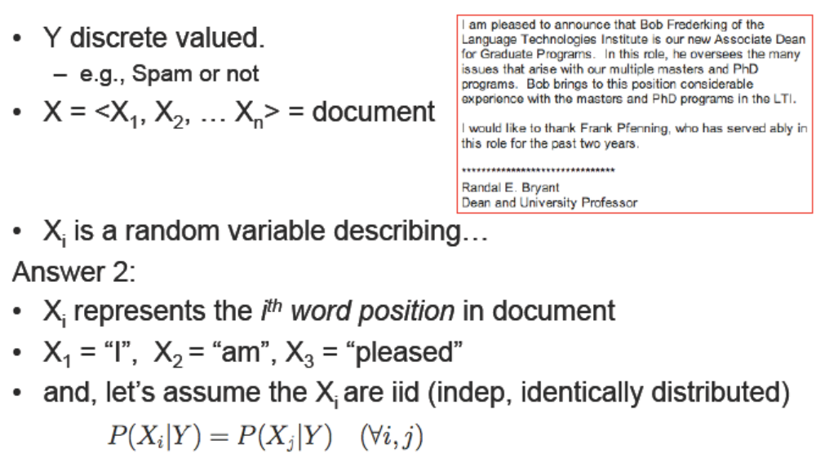
Learning to classify documents: P(Y|X)

Slide 24
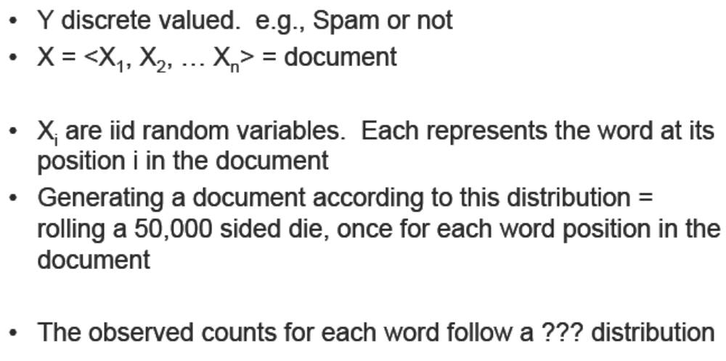
Learning to classify documents: P(Y|X)
The “Bag of Words” model

Slide 25
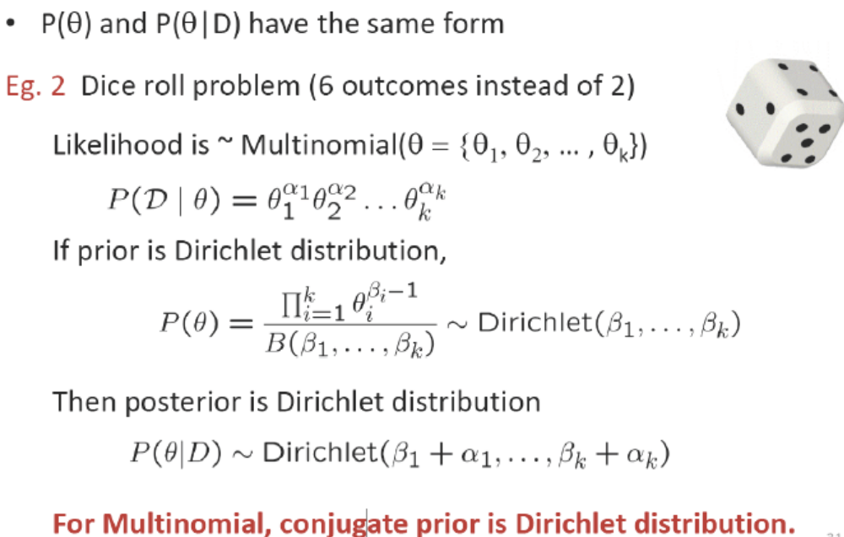
Multinomial Distribution

Slide 26
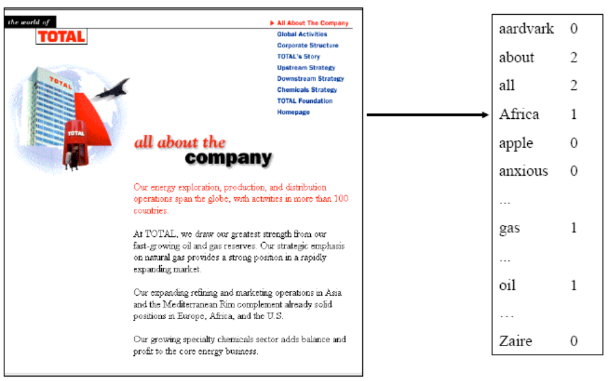
Multinomial Bag of Words

Slide 27
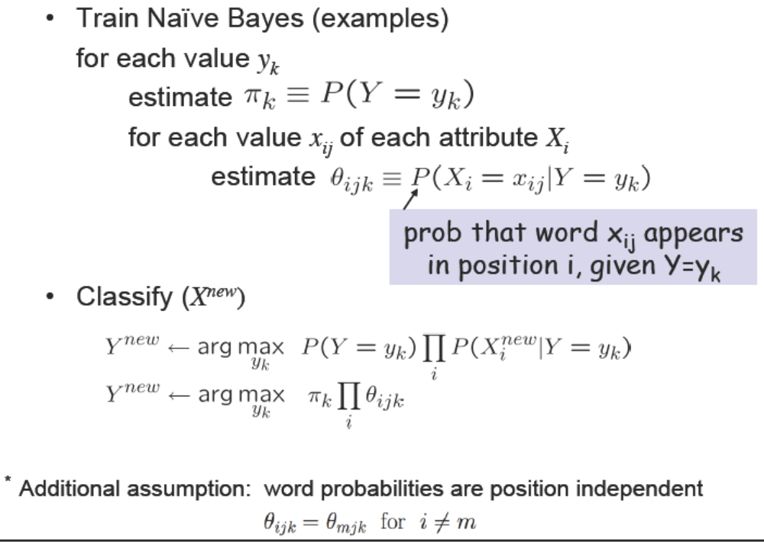

Slide 28
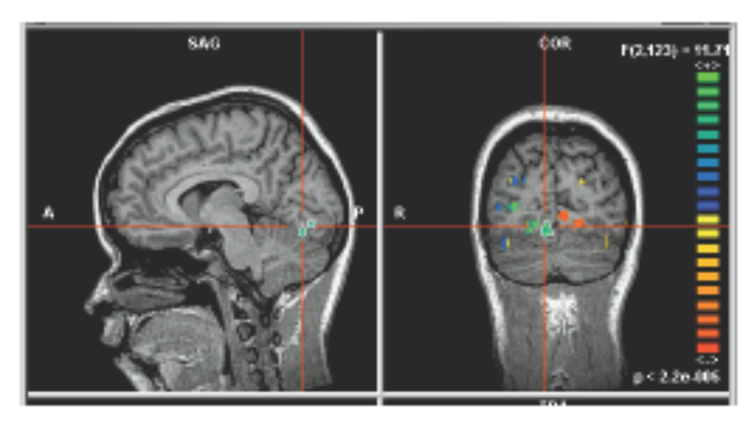
What if we have continuous X_{i}
E.g., image classification
X_{i} is i^{th} pixel

Slide 29

What if we have continuous X_{i}
Still have:
Just need to decide how to represent P(X_{i}|Y)

Slide 30

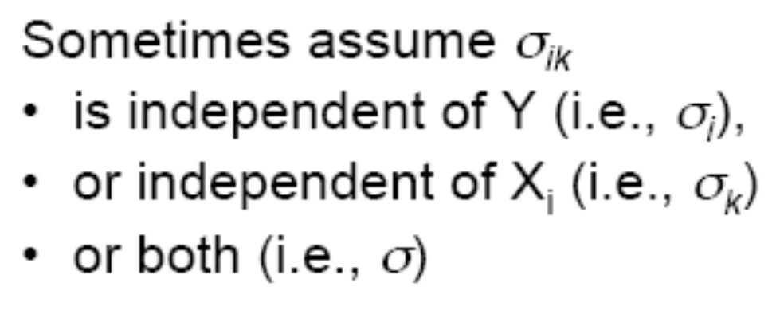
What if we have continuous X_{i}?
E.g., image classification: X_{i} is i^{th} pixel
Gaussian Naive Bayes (GNB): assume

Slide 31
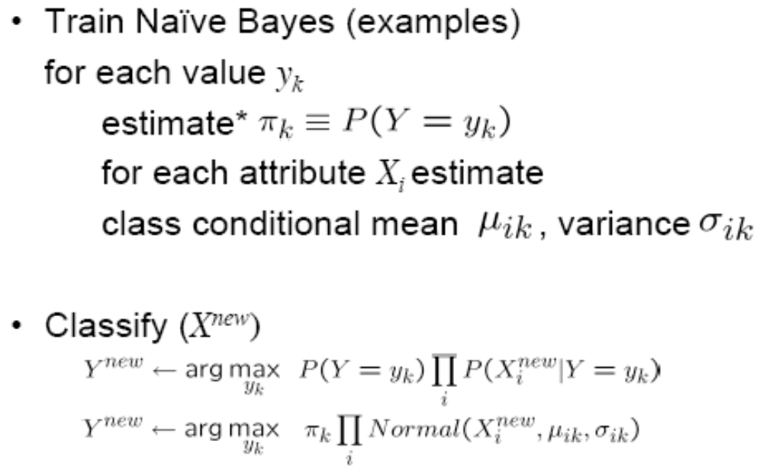
Gaussian Naive Bayes Algorithm
Continuous X_{i}, still discrete Y

Slide 32
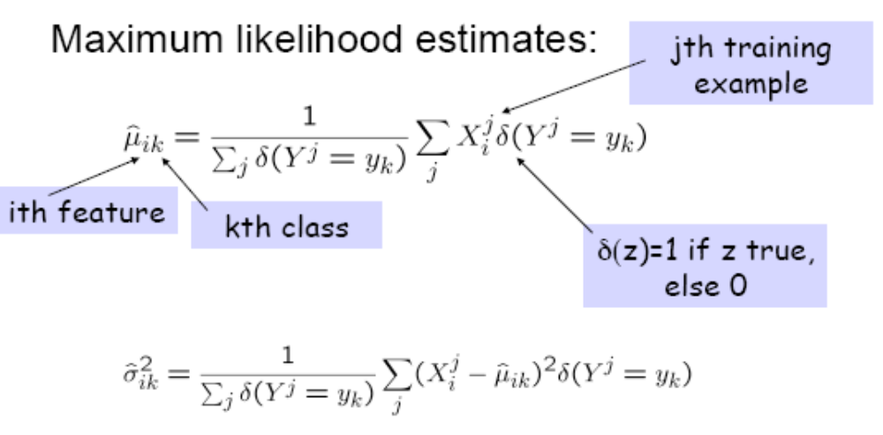
Estimating Parameters: Y discrete, X_{i} continuous

Slide 33
GNB Example
Classify a person’s cognitive activity, based on brain image
  Are they reading a sentence or viewing a picture?
  Reading the word “Hammer” or “Apartment”?
  Viewing a vertical or horizontal line?
  Answering the question, or getting confused?

Slide 34
What you should know
Training and using classifiers based on Bayes Rules
Conditional independence
  What it is
  Why it’s important
Naive Bayes!
  What it is
  Why we use it so much
  Training using MLE, MAP estimates
  Discrete variables and continuous (Gaussian)

